Slide 1

Energy Well attention
Soumick Sarker

Slide 2
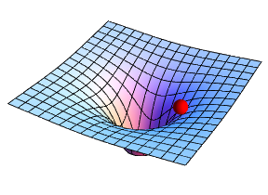
agenda
Introduction & Motivation
Concept of Energy-Well Attention
Mathematical Foundations
Energy Well Variants & Configurations
Implementation & Experimental Setup
Results & Performance Analysis
Future Work & Open Challenges
Conclusion & Q&A

Slide 3
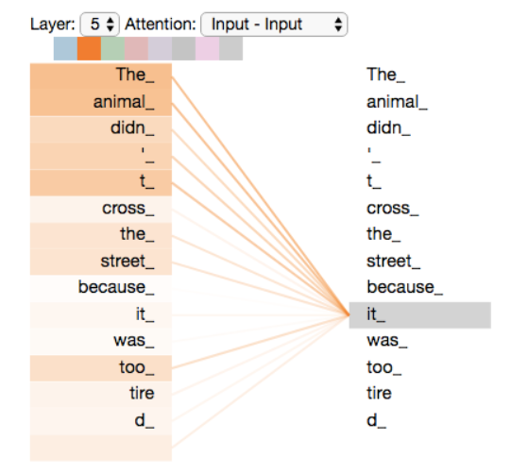

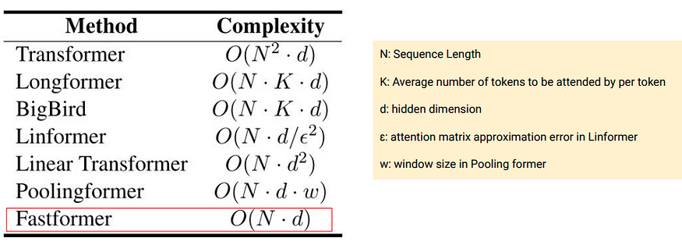
Introduction
Standard self-attention treats all tokens equally
Challenges with Self-Attention
No explicit modeling of distance
Computationally expensive (O(N²) complexity)
Poor handling of inter-cluster relationships
Solution: Energy-Well Attention
Introduces distance-aware attention
Reduces unnecessary computations
Captures inter-cluster dependencies
Notes:
Transformers rely on self-attention, which works well but has critical limitations. It treats all tokens equally, lacking a notion of distance. This leads to inefficiencies and poor inter-cluster modeling. Our approach, inspired by physics, introduces energy wells to address these problems.

Slide 4
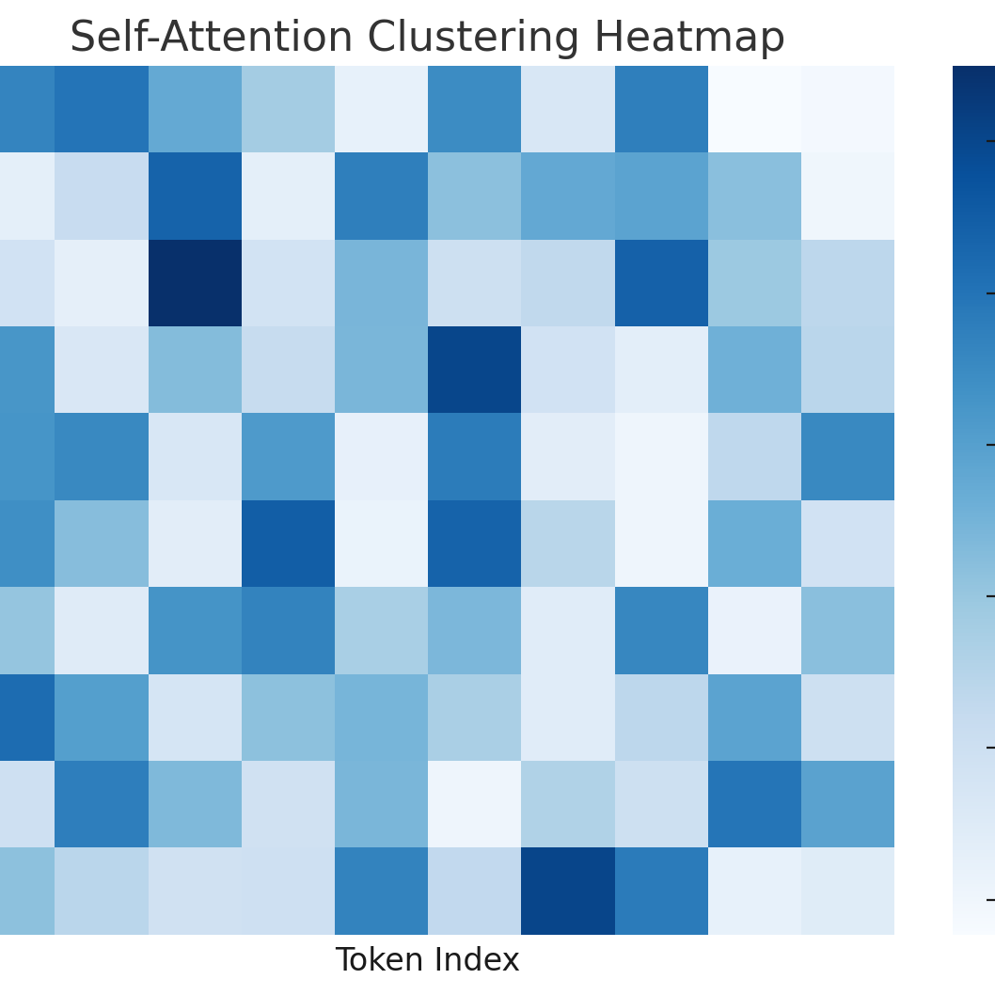
Why does clustering occur in self-attention?
If certain tokens have high similarity (i.e., dot product of 𝑄⋅𝐾^{T} is large), they receive higher attention weights. This naturally causes related tokens to form clusters where they strongly attend to each other.
Since self-attention is computed across all tokens, words that are semantically or syntactically related tend to form local attention clusters.
As information propagates through transformer layers, self-attention refines the features by redistributing attention weights. Early layers capture local clustering. Deeper layers capture semantic clustering.
In multi-head attention, Some heads capture short-range, while others capture long-term dependencies. Which creates hierarchical clustering, where words are grouped based on shared attributes across heads.
If multiple tokens convey similar meanings (e.g., synonyms, repeated words), their attention values tend to be similar. This redundancy leads to clusters in attention maps.

Slide 5
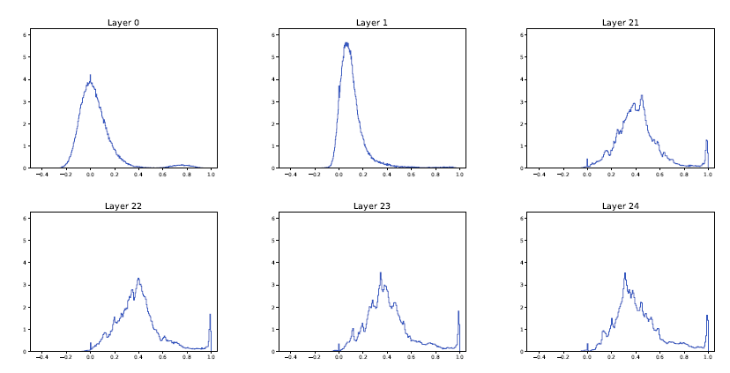
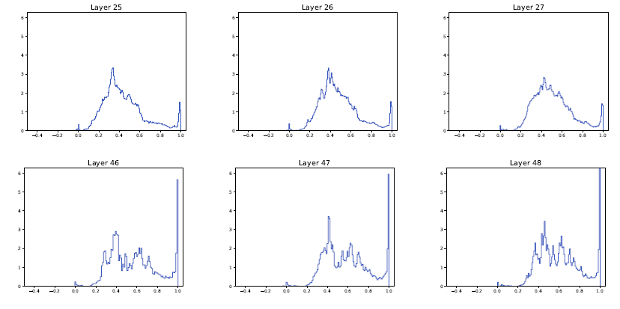
in this context we used a pre-trained ALBERT XLarge v2 model which has constant parameter matrices. Here we randomly selected a single prompt and then generate the histogram of the pairwise inner products. We see the progressive emergence of clusters all the way to the 24th hidden layer, as evidenced by the growing mass at 1. If the number of layers is increased, up to 48 say, the clustering is further enhanced
Studies on attention visualization (e.g., BERT Attention Visualization) show that:
Local phrases cluster together in early layers.
Named entities cluster together in middle layers.
High-level concepts cluster together in deeper layers.

Slide 6

Energy Well attention

Slide 7
Energy Well Conceptualization
Inspired by Physics: Each token is like a particle in an energy field
Replaces Dot-Product Similarity with an energy function
Tokens exert influence based on distance
Nearby tokens have stronger connections
Distant tokens have weaker influence

Slide 8
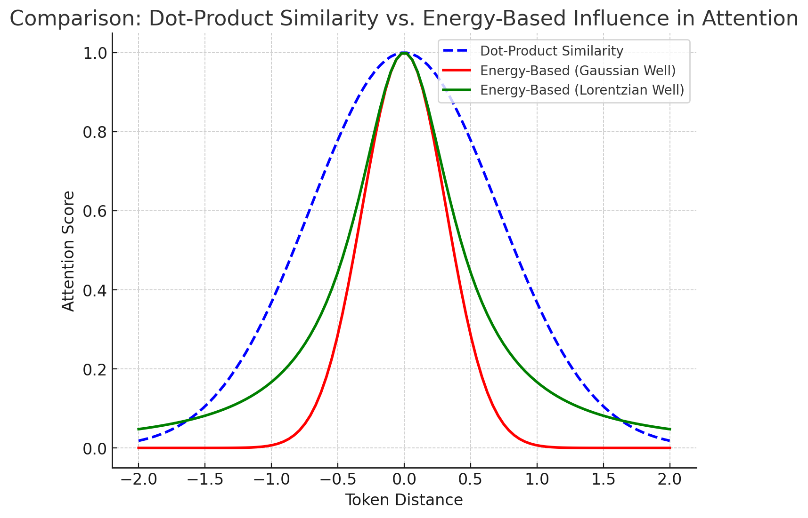
How does energy well attention differ from self attention?
Sharp decay controlled by function parameter, leading to localized attention
Tokens within a certain range receive higher attention.
For Lorentzian well, Tokens further away still retain some influence.
Notes:
Instead of computing similarity using dot-product attention, we treat each token as a particle exerting energy on others. The influence of a token decays over distance, which introduces a natural, interpretable attention spread.

Slide 9

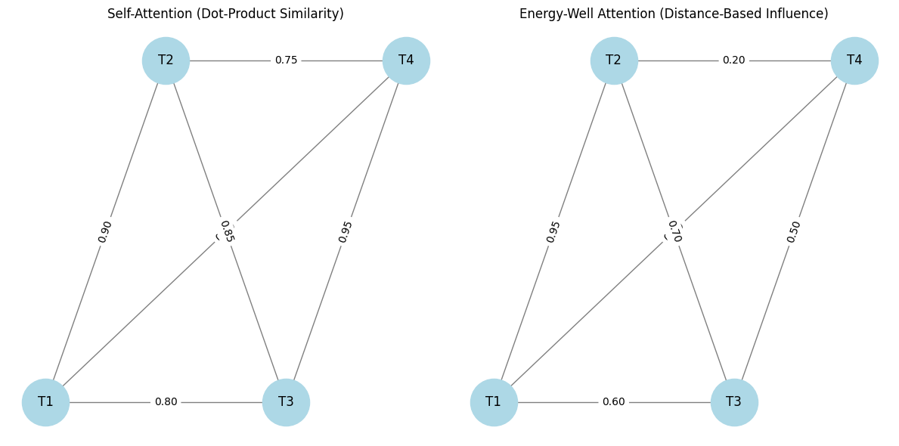

Mathematical formulation
Alpha controls the decay rate
The gaussian function is very sensitive the choice of alpha
More agility and adaptability
Stronger competitive edge

Slide 10
Why is there a need for an alternative to self-attention?
Infancy of ML
Statistical and probabilistic models
Modern ML
Usage of larger and more powerful hardware to train huge models
The need for efficient computation and larger sequence handling
ML in Future

Slide 11
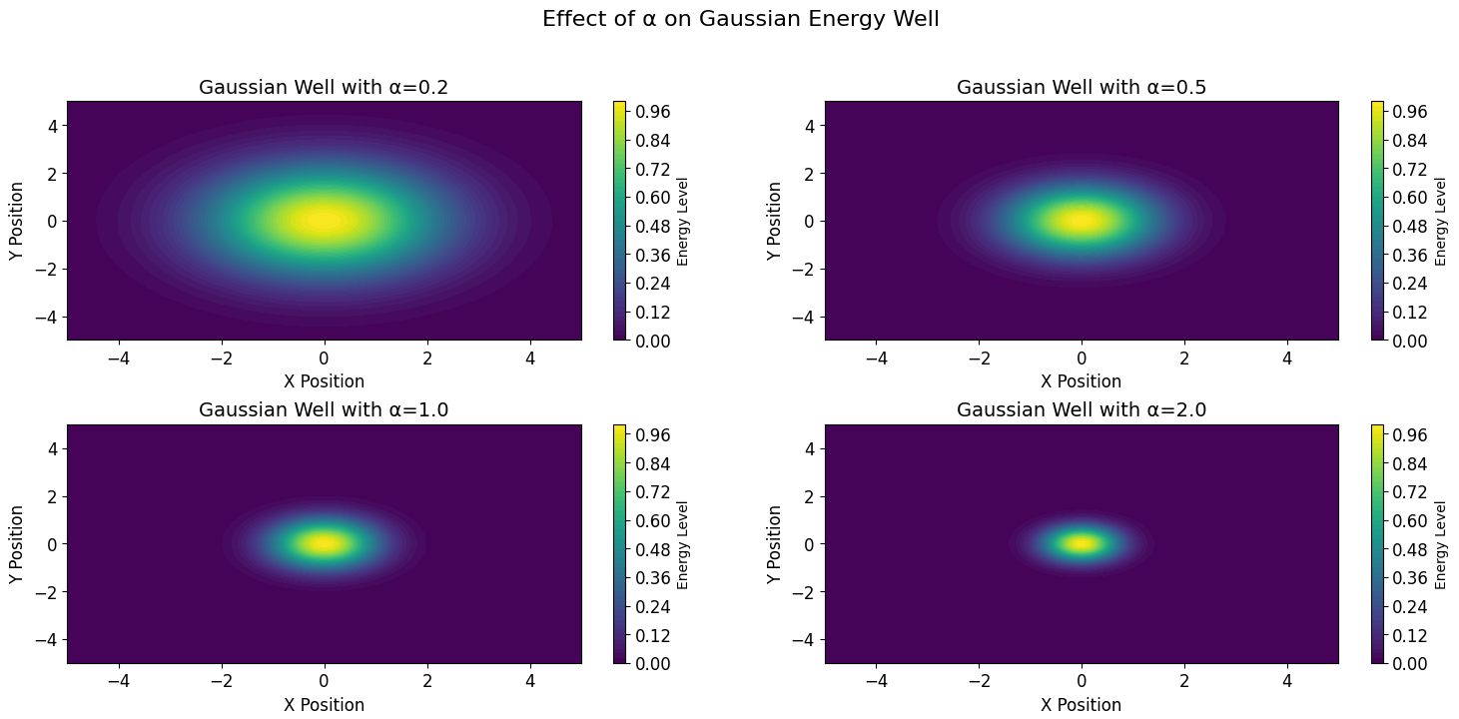
Influence with well type
Energy Well Type | Influence
Gaussian | Localized, rapid decay
Lorentzian | Broader, long-range influence
Inverse Square | Exponential spread
Notes:
We have different types of energy wells, each suitable for different applications. Gaussian wells focus on nearby tokens, Lorentzian wells spread attention more widely, and inverse-square wells capture long-range dependencies.

Slide 12
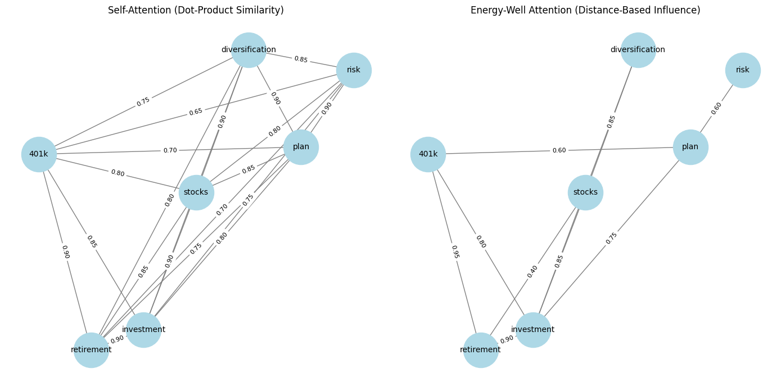
How is textual data handled

Slide 13
Advantages of using energy well attention
Factor | Self Attention | Energy Well Attention
Pairwise Token Computation | O(N²) | Localized attention: O(N) Sparse attention: O(NlogN)
Memory Usage | High (stores all pairwise interactions) | Lower (only stores active influences)
Efficiency in Long Sequences | Inefficient due to quadratic scaling | More efficient (adaptive attention spread)
Parallelization | Needs full attention matrix computation | 1. Sparse Matrix calculations or 2. Parallel Localized matrix calculations

Slide 14
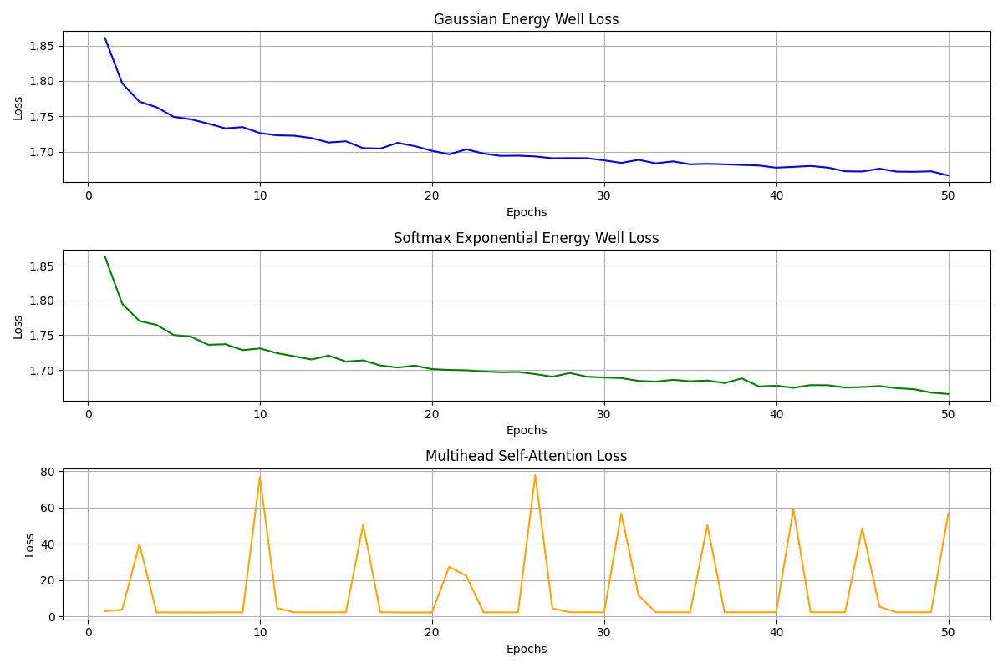
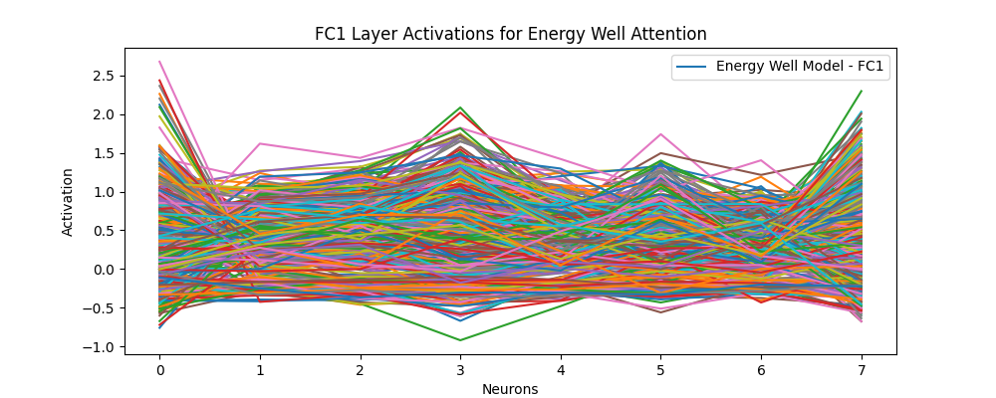
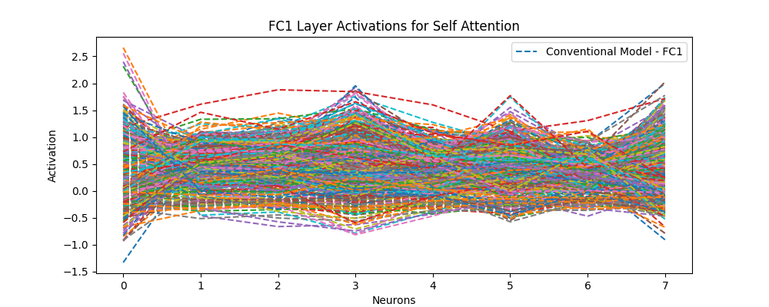
Experimental results on cifar-10

Slide 15
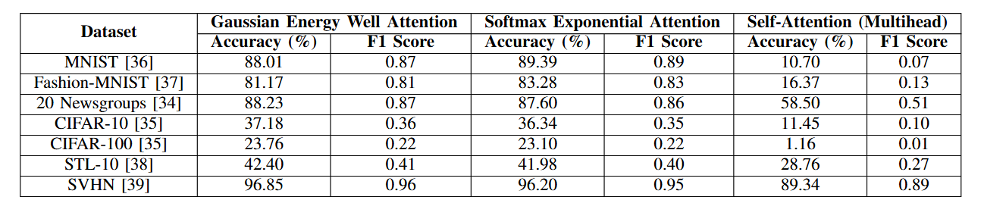
Results on other datasets
Notes:
This method has vast potential, from multi-modal learning to large-scale Transformers. Future work will focus on making these wells trainable and scalable

Slide 16
Summary
Potenital and future scope
Limitations
Energy-Well Attention is interpretable, efficient, and accurate
Significant improvement over self-attention in clustered data
Can be used to speed up calculations in transformer backbones
While learnable parameters enhance adaptability, they may introduce overfitting risks on smaller datasets
Reliance on pairwise distance calculations may pose scalability challenges for extremely large datasets.
Hand controlled hyperparameters on current modelling.

Slide 17

Thank you
GitHub || Paper Link

